Slide 1
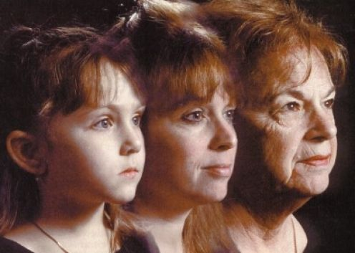
Global Issue in Middle East
Issue : Ageing

Slide 2
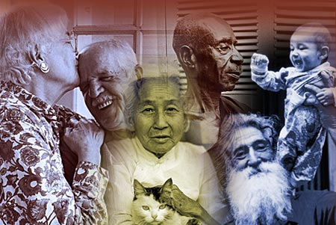
Elderly Care in Middle East
Middle Eastern countries have certain cultural, social and economic characteristics in common. The percentage of elderly in the Middle East is expected to increase with improvement of health care delivery in the area. There is a need to ensure the availability of health and social services for older persons and promote their continuing participation in a socially and productive life. They are doing there best to have better elderly care, health care, and just have a better care for them. Policymakers in the developing world need to invest soon in formal systems of old-age support to be able to meet these challenges in the coming decades.

Slide 3
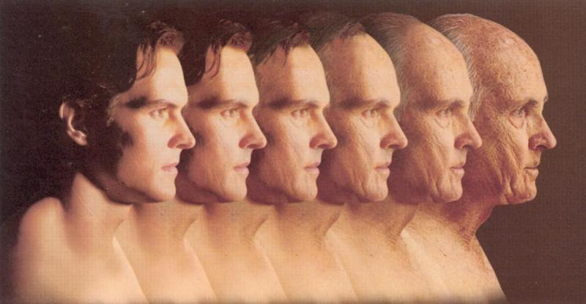
Background
The world's elderly population is quickly growing, both in its absolute numbers and in its percentage relative to the younger population. It is currently estimated that more than half of all people who are 65 years and older live in developing nations. The world's older population experiences a net increase of 1.2 million each month, 80 percent of which occur in Third World nations. It is projected that by the year 2025, the total elderly population will reach 976 million with 72% living in developing regions.

Slide 4
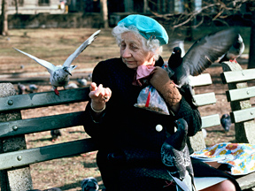
Impact of The UN.
The world needs to do more to prepare for the impact of a rapidly ageing population, the UN has warned, particularly in developing countries. Within 10 years the number of people aged over 60 will pass one billion, a report by the UN Population Fund said. The UN agency also said more had to be done to tackle "abuse, neglect and violence against older persons. The elderly population is expected to swell by 200 million in the next decade to surpass one billion, and reach two billion by 2050. "In many developing countries with large populations of young people, the challenge is that governments have not put policies and practices in place to support their current older populations or made enough preparations for 2050," the agencies said in a joint statement.

Slide 5

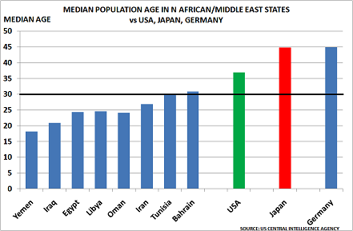
Ageing Chart Compared to U.S.A

Slide 6
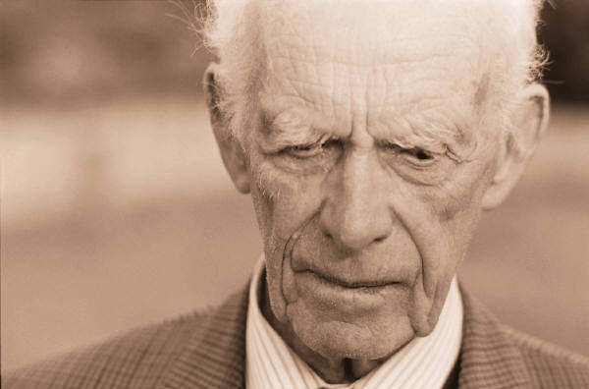
Future For Ageing in Middle East
Problems in providing health care involve obtaining adequate information, “demanding behavior” by a patient's family, conflicting beliefs about planning ahead and differing patterns of communicating grave diagnoses or “bad news.” There are guidelines that will provide an understanding of the cultural characteristics of Middle Easterners and, therefore, will improve rather than impede their health care. A personal approach and continuity of care by the same health care professional help to bridge the gap between Middle Eastern cultures and Western medical culture. In addition, periodic use of cultural interpreters helps ameliorate the intensity of some cultural issues.

Slide 7
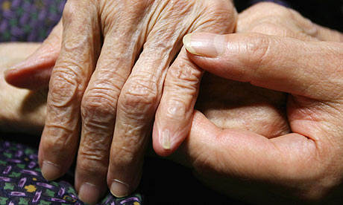
Middle East Powerpoint
Done By: Blake Maines

