Slide 1
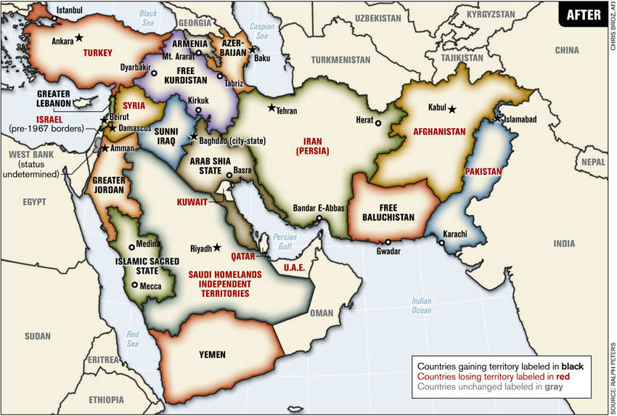
The Middle Eastern Countries
By: Blake Maines

Slide 2

Tunisia
In 2009, they held there first elections.
On June 23rd the second elections will be held.
The two political parties are the congress for the republic and the Ettakatol.

Slide 3
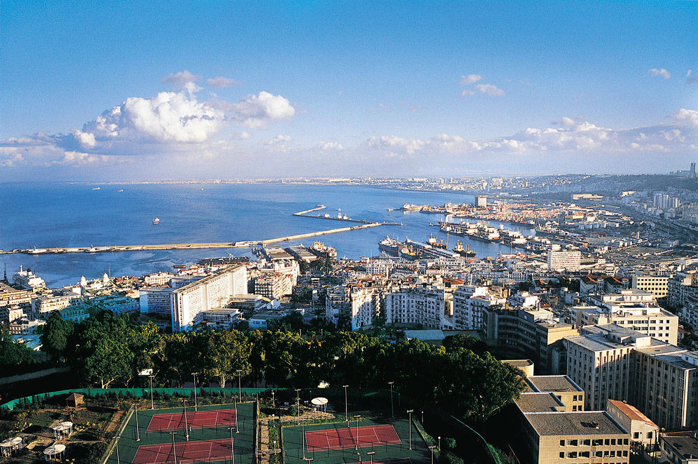
Algeria
The civil war in Algeria has never came to a conclusion.
Al Qaeda is helping spread the conflict into the Sahel region.
Riding food prices in Algeria has caused many outbreaks of riots and protests.
The protest have no affiliation with any political parties.

Slide 4
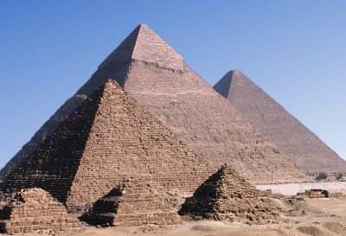
Egypt
Egyptians are participating in elections, which they have not done in over half a century.
200 million dollars have been raised for education reform in Egypt.
Over 70 % of eligible voters voted.
The media is partisan, not objective, just like America.

Slide 5
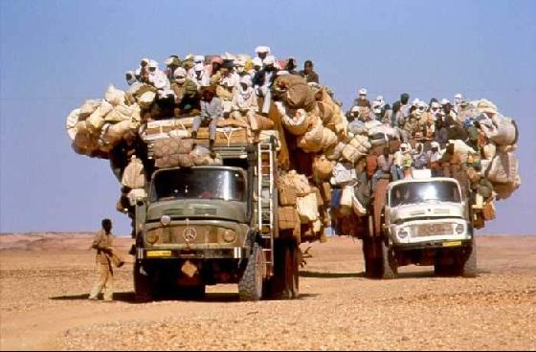
Libya
September 11,2012, Libyans attacked the US consulate. The US consulate was burned and four other Americans were murdered.
Obama used the attack as motivation by a video that was released.
The US government has denied funds for the defense in Libya while the Chevy volt were given.

Slide 6
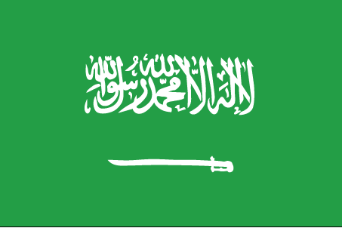
Saudi Arabia
The UK has recently pissed off the Arabs.
They started an inquiry about how the UK can “ encourage democratic and liberalizing reforms in Saudi Arabia”
Changes need to be made in Arabia to catch up with the rest of the world.
Women's rights are at least a century behind most other countries in the world.

Slide 7

Jordan
When King Abdullah II dissolved the countries parliament, thousands of protests occurred.
The rallies were peaceful and called for constitutional reforms, because the king has to much power.
Protesters demanded that representative need to be implemented in a democratic system.

Slide 8
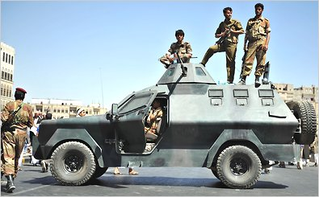
Yemen
Yemen is having the same problems that the rest of the middle east is having.
The number of malnourished children has increased by 83 %.
The number of people in Yemen have, limited access to food has doubled.

Slide 9
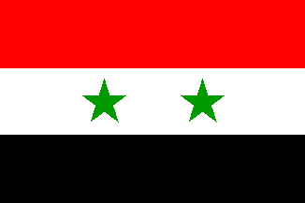
Syria
In Syria, there is a rising number of people rebelling against the President Assad.
Most the rebels have formed a alliance together to fight.
If all of the Anti-Assad fought together, the fall of Assad will happen much quicker.

